Slide 1
Week 07: Loops CS 110 - Introduction to Programming
Brother W. Clements

Slide 2

Prepare
Questions about
Infinite vs Finite
Collections – intro more week 9-10
Current: Boolean(True/False) < int < float & string
Array - numeric, same type
[] – list: order: append, insert, sort,
{} – dictionary: no-order
Loops
Exit strategy, container
For var in […] @[]-list
Array
range
While (<condition>)
Must change the condition - exit, or stack overflow
len
When to use?
For: I know the beginning and end – finite
While: I don’t know when it will end – infinite
Nesting loops
Method | Lists Description
append() | Adds an element at the end of the list
clear() | Removes all the elements from the list
copy() | Returns a copy of the list
count() | Returns the number of elements with the specified value
extend() | Add the elements of a list (or any iterable), to the end of the current list
index() | Returns the index of the first element with the specified value
insert() | Adds an element at the specified position
pop() | Removes the element at the specified position
remove() | Removes the item with the specified value
reverse() | Reverses the order of the list
sort() | Sorts the list

Slide 3
Structure Chart – What do you know?
Program
Intro I/O
Input
Files
Output
variables
Input
Process
Output
Intro Algorithms
<str> = Input(<str>)
Variables (int, float, str, bool)
Print(string)
loop (condition)
If (condition)
variables
Operators:
= (assignment)
+ (add/append)
types
Lists
str
float.
int
Intro Data Structures
Cans of nothing
“ “, \t, \n, 0, ?

Slide 4
Program
Input
Magic
(equations)
(algorithms)
(etc)
Process
Output
Str prompt
Patterns:
Var = var operator var
#:operators: +, -, *, /, //, %, **
Var = var.function()
⌨️
input(<str>
Str “”
=
Var
Strings: +, .functions()
Numbers: math
float( )
If(decimal)
int( )
bool:operators (==, <, > <=, >=)
If(whole)
If boolean:
T-statements
F-statements
T-statements
while boolean:
Var
F-statements
+
f”. {} “
:.#f
If(decimal)
str( )
str( )
“ {} “.format(var..)
If(whole)
If(str)
📺
VarStr = input(“prompt?”)
VarF = float(VarStr)
VarI = int(VarStr
Str “”
print(<str>)
“ “, \t, \n

Slide 5
What is a loop
Previous code
T
If boolean:
F
An if statement is a branch in code
So is a loop, but it repeats itself
What are while best used for:
Verifying prompted user info.
Reading files
Not knowing when to end.
Things to be careful about
Infinite loops –
“this is the song that goes on and on my friend”
Have an exit planned
T-statements
F-statements
After code
Previous Code
while boolean:
F
T-statements
T
After Code

Slide 6
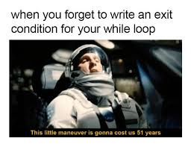
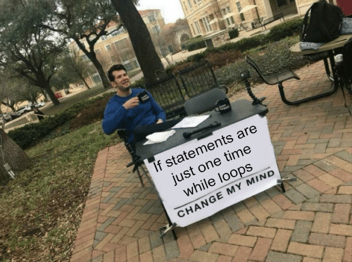

Lecture
See Classroom example
Containers
Default Conversion
Lists: strings, array, range
Dictionary
While
have an exit plan – Boolean
Don’t know when to end.
Using debug flags
Conversion of values
Other Cans of Nothing
Empty cans of cans of nothing
Defining keys
Working with “ vs ‘ or using variable instead
Formatting a list of values to output
Having an exit plan
Working with multiple input
Nested loops

Slide 7
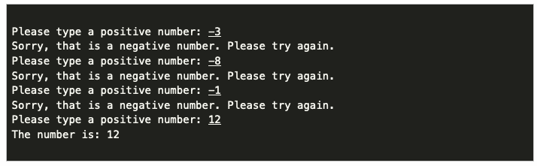
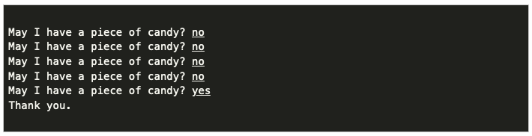
07 Prepare: Checkpoint
Write a Python Program that does each of the following:
Use a while loop to ask the user for a positive number (>= 0). Continue asking as long as the number is negative, then display the number. For example:
Use a while loop, to simulate a child asking their parent for a piece of candy. Have the program keep looping until the user answers "yes", then have the program output "Thank you." For example:

Slide 8
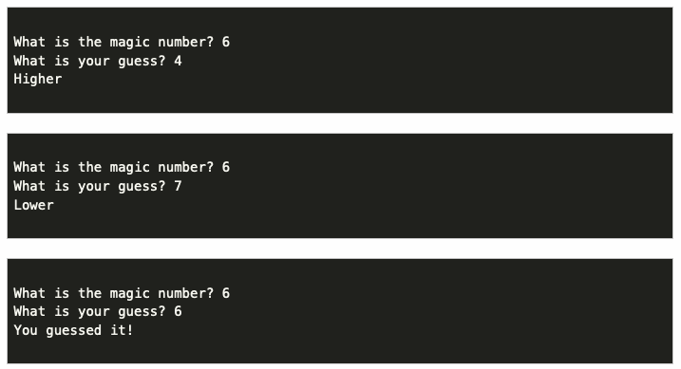
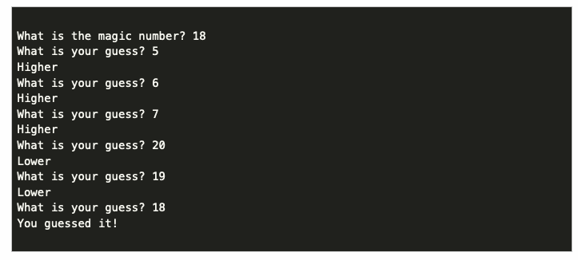
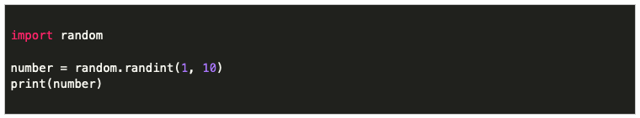
07 Teach: Team Activity Guess My Number Game
In the Guess My Number game the computer picks a magic number, and then the user tries to guess it. After each guess, the computer tells the user to guess "higher" or "lower" until they guess the magic number.
Having the computer pick a random number
Core Requirements
Start by asking the user for the magic number. (In future steps, we will change this to have the computer generate a random number, but to get started, we'll just let the user decide what it is.)
Ask the user for a guess.
Using an if statement, determine if the user needs to guess higher or lower next time, or tell them if they guessed it.
At this point, you won't have any loops.
Add a loop that keeps looping as long as the guess does not match the magic number.
At this point, the user should be able to keep playing until they get the correct answer.
Instead of having the user supply the magic number, import the random library and use it to generate a random number from 1 to 100.
Play the game and make sure it works!
Stretch: Number of guesses or Play again or
Wheel of Fortune.

Slide 9
07 Teach: Team Activity Guess My Number Game
Start by asking the user for the magic number. (In future steps, we will change this to have the computer generate a random number, but to get started, we'll just let the user decide what it is.)
Ask the user for a guess.
Using an if statement, determine if the user needs to guess higher or lower next time, or tell them if they guessed it.
At this point, you won't have any loops.

Slide 10
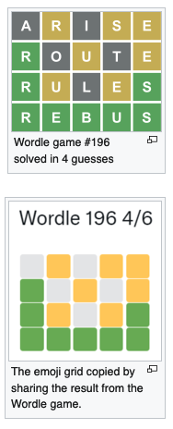
07 Prove: Assignment Milestone
Wordle is a web-based word game that became popular online in the early part of 2022. (You can learn more about it from the Wordle Wikipedia page.)
Cross between Wheel of Fortune and Master Mind
Overview of Game:
The program contains a hidden secret word stored in a variable. This word can have any number of letters in it. When the program runs, the user is shown underscores ( _ ) for each letter of the word.
The user then enters a guess. If the guess is correct, the user wins and the game is over.
If the guess is not correct, the user will be given a hint to help them improve their guess for the next round.
The game continues prompting the user for new guesses and showing them hints until they guess the word correctly. When the game is over, the program displays the number of guesses that were made.
The guess must be the same number of letters as the secret word. If the guess has a different numbers of letters, the user is given a message explaining this, and no hint is provided.
The hint is a rendering of the letters in the guess according to the following guidelines:
An underscore _ indicates that the letter was not present in the secret word.
A lowercase letter indicates that the letter was present somewhere in the secret word, but not at that position.
An uppercase letter indicates that the letter was present at that exact spot in the secret word. (In other words, if the second letter in the guess is also the second letter in the secret word, then that letter is shown as a capital.)

Slide 11
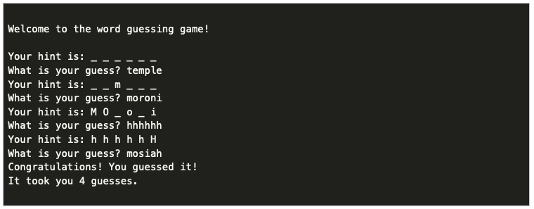
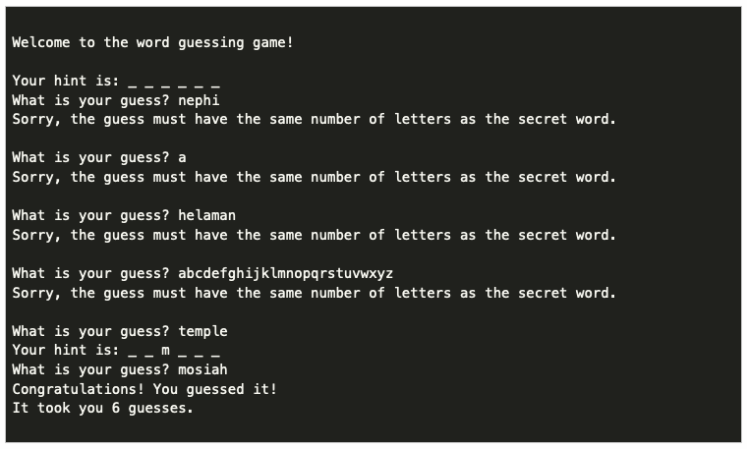
07 Prove: Assignment Milestone
For example, if the secret word were: mosiah, then the program would initially display:
Your hint is: _ _ _ _ _ _
If the user's guess were: temple, they would learn that the m in temple is the only letter in the secret word, but it is in the wrong spot, so it would be displayed in lowercase as shown:
Your hint is: _ _ m _ _ _
But if the user instead guessed: moroni, they would receive the following as a hint:
Your hint is: M O _ o _ i
Notice that in the hint above, the M and the first O from moroni are capitalized, because those letters are also the first two letters of mosiah.

Slide 12
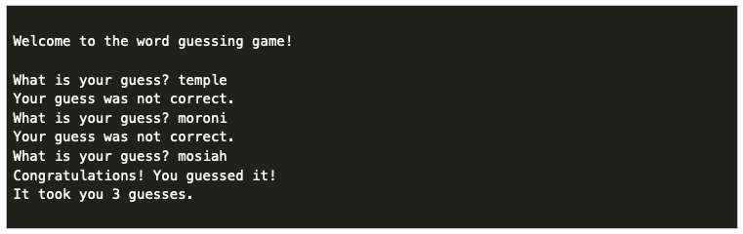
07 Prove: Assignment Milestone
Milestone is not the assignment, but progress
At the end of Lesson 07, to help make sure you are on track to finish the assignment, you need to complete the following:
Have a secret word stored in the program.
Prompt the user for a guess.
Continue looping as long as that guess is not correct.
Calculate the number of guesses and display it at the end.
You do not need to have any hints at this point.
The following shows the functionality of the program at this point:

Slide 13
07 Prove: Assignment Milestone
Final Requirements
Add the hints according to the rules above.
Add a check to verify that the length of the guess is the same as the length of the secret word. If it is not, display a message. If they are the same, then proceed to give the hint.
Make sure to account for the following in your hints:
Letters that are not present at all in the secret word (underscore _).
Letters that are present in the secret word, but in a different spot (lowercase).
Letters that are present in the secret word at that exact spot spot (uppercase).
For the final requirements, you will need to know week08 information (for loops).
You will have if, while, and for statements.

Slide 14

Checkpoint
colors = ["red", "blue", "green", "yellow"]
red
blue
green
Yellow
1
2
3
4
5
6
7
8
May I have a piece of candy? no
May I have a piece of candy? no
May I have a piece of candy? no
May I have a piece of candy? no
May I have a piece of candy? yes
Thank you.
Steps
Read instructions -
Demonstrate your understanding of loops by completing the following individual checkpoint assignment.
Attempt coding the problem for 1 hour
For: colors, numbers,
While: prompt
Test:
Colors appear
1 not 0
8 not 7
Yes the 1st time.
Look at the Instructor code after 1 hour or when done.
Include in notes, what you learned from the instructor's code

Slide 15

Teach: Team Activity List of Numbers
Meet and setup a video call, share screen
Overview
In the Guess My Number game the computer picks a magic number, and then the user tries to guess it. After each guess, the computer tells the user to guess "higher" or "lower" until they guess the magic number.
Core requirements
Having the computer pick a random number
Loop until number is guessed
import random
number = random.randint(1, 10)
Stretch Challenge
Track number of guesses
End on yes
Teacher Solution
Submission
In notes tell me what you learned from the teacher solutions.
What is the magic number? 6
What is your guess? 4
Higher
What is the magic number? 6
What is your guess? 7
Lower
What is the magic number? 6
What is your guess? 6
You guessed it!

Slide 16



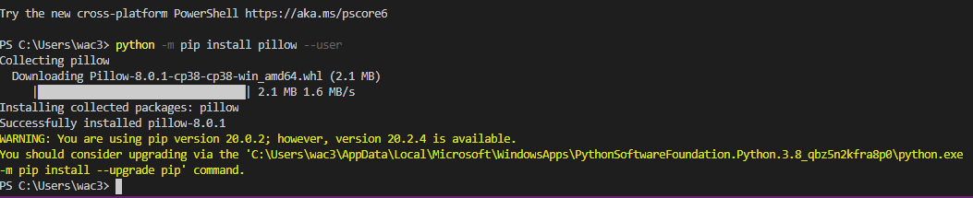
Prove (Milestone)
Overview
A digital image is composed of a number pixels arranged in a grid. Each of these pixels is a color that can be represented as a red, green, and blue (RGB) value. These values range from 0 to 255 for each of the red, green, and blue components. So if a pixel had a red value of 255, and a green value of 0, and a blue value of 255, it would appear as one bright purple dot (mix of red and blue) in the picture.
Program the following:
Read the whole assignment, watch videos
Download and save image file (recommend creating a folder for all this)
Install python library
Open image files in program
Iterate through pixels
Use if statement for decision
Produce new image
Milestone
Library working, open image, add red pixels, display image.
Make sure you are in the right directy, cd (use tabs to auto complete)
Make it your own
Creative: You could consider adding better formatting (for example, aligning the prices), storing extra information, such as the quantity of the items in the list, or you can add anything else you think of to make the shopping cart better.
Milestone: Submission
When the Milestone is complete, answer the questions in the associated quiz in I-learn.

Slide 17
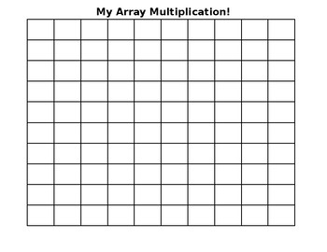

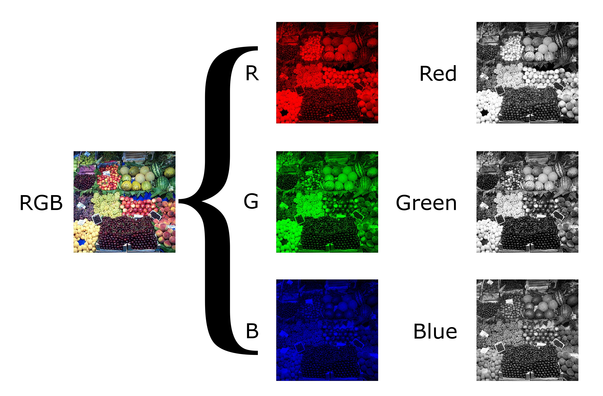
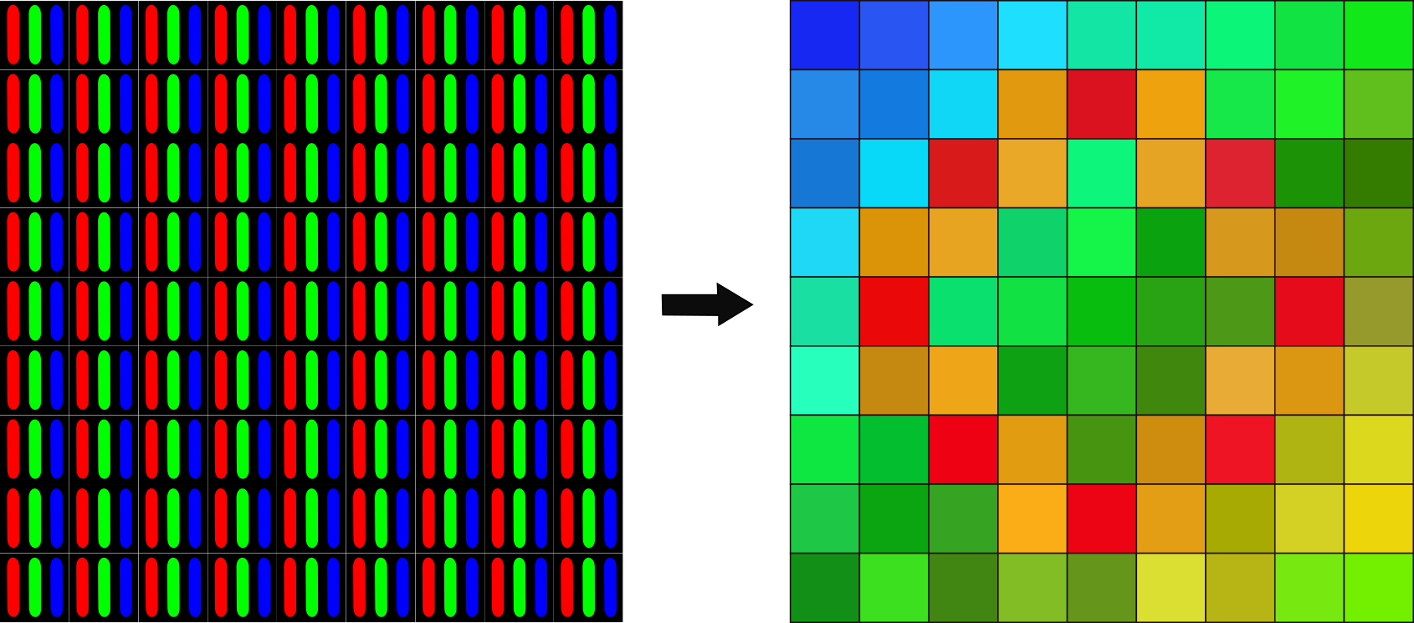
(X=0,Y=0)
(X=0,Y=0)
(X=0,Y=0)
(X=0,Y=0)

Slide 18
(X,Y)
(X,Y)
(X+width,Y+height)
(X+width,Y+height)
image_original = Image.open("beach.jpg")
image_new = Image.new("RGB", image_original.size)
width, height = image_original.size
(X,Y)
pixels_original1 = image_original.load()
pixels_new = image_new.load()
r1, g1, b1 = pixels_original[x, y]
r1 = r1 + 100
pixels_new[x, y] = (r1, g1, b1)

Slide 19
(X,Y)
(X,Y)
(X,Y)
(X+width,Y+height)
(X+width,Y+height)
(X+width,Y+height)
image_original = Image.open("beach.jpg")
image_original = Image.open(“catus.jpg")
image_new = Image.new("RGB", image_original.size)
width, height = image_original.size
width, height = image_original.size
(X,Y)
pixels_original1 = image_original.load()
pixels_original2 = image_original.load()
pixels_new = image_new.load()
r1, g1, b1 = pixels_original[x, y]
r2, g2, b2 = pixels_original[x, y]
pixels_new[x, y] = (r3, g3, b3)
LOGIC: "if g is greater than something and r and b are less than something else, do the following." ***Hint copy either pixel 1 or pixel 2 into new

Slide 20

How THIS wallpaper kills your phone
Video: https://www.youtube.com/watch?v=iXKvwPjCGnY

